Slide 1
Introduction to Simplicial Complexes
by
Waqar Hussain Shah

Slide 2
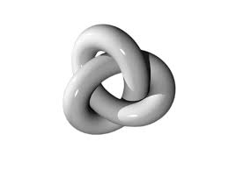
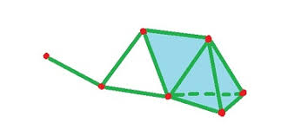
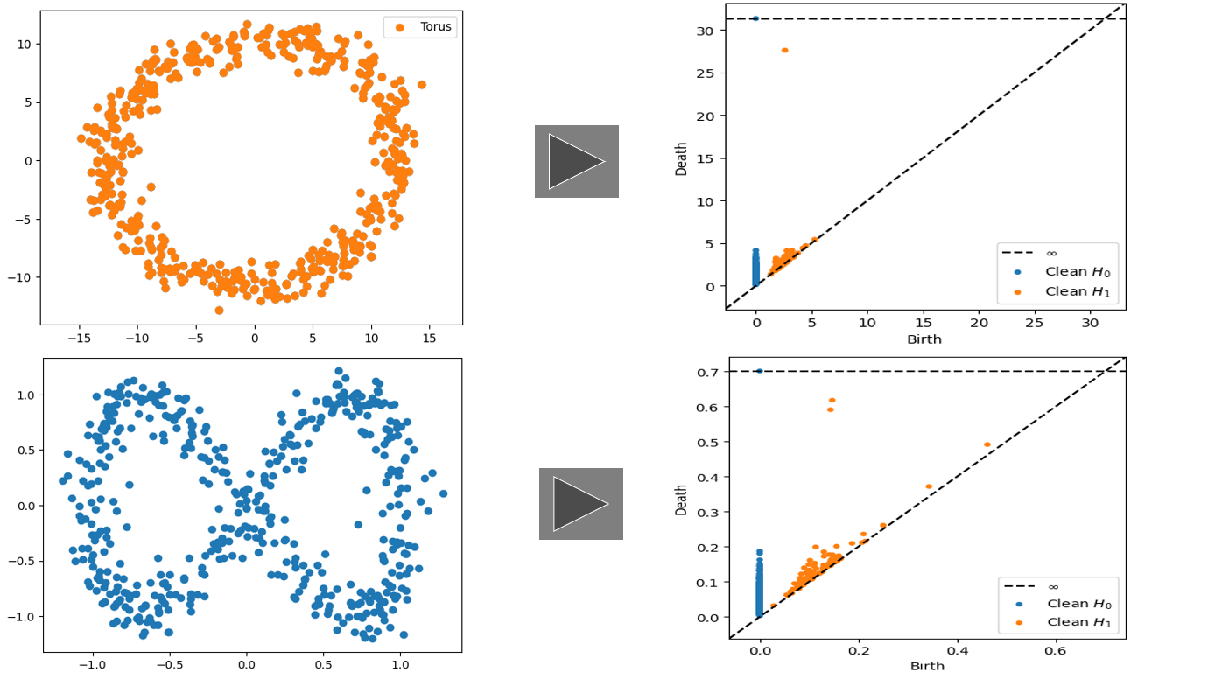
Content:
What is Topology
Simplicial Homology
Structure of Simplexes
Some Complexes
What is TDA?

Slide 3
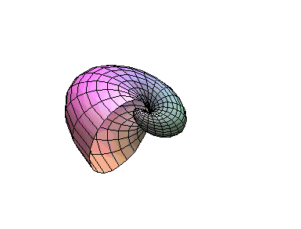
Topology

Slide 4
What is Topology?
Definition: A topology on a set 𝑋 is a collection 𝜏 of subsets of 𝑋 having the following properties.
1: Φ and 𝑋 are in 𝜏.
2: The union of the elements of any subcollection of 𝜏 is in 𝜏.
3: The intersection of the elements of any finite subcollection of 𝜏 is in 𝜏.
A set 𝑋 for which a topology 𝜏 has been specified is called a topological space. Precisely a topological space is a pair (𝑋, 𝜏) consisting of set 𝑋 and a topology 𝜏 on 𝑋. An element of 𝜏 is called open set.

Slide 5
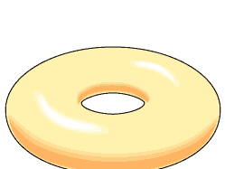
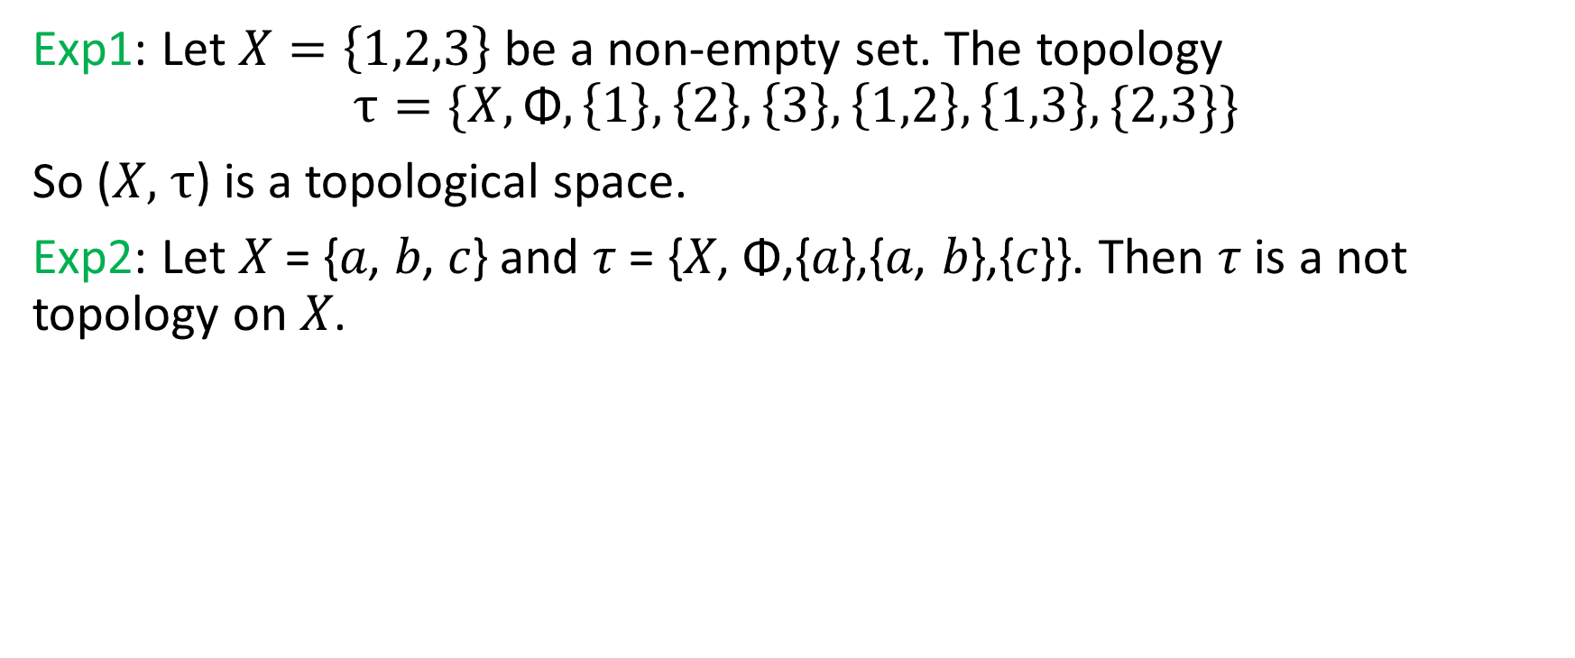
Example:
Exp1: Let $X=\left\{1,2,3\right\}$be a non-empty set. The topology
$$τ=\{X,\text{Φ},\left\{1\right\},\left\{2\right\},\left\{3\right\},\left\{1,2\right\},\left\{1,3\right\},\{2,3\}\}$$
So ($X,$ $τ$) is a topological space.
Exp2: Let 𝑋 = {𝑎, 𝑏, 𝑐} and 𝜏 = {𝑋, Φ,{𝑎},{𝑎, 𝑏},{𝑐}}. Then 𝜏 is a not topology on 𝑋.

Slide 6
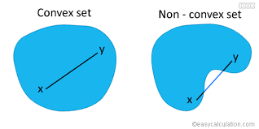
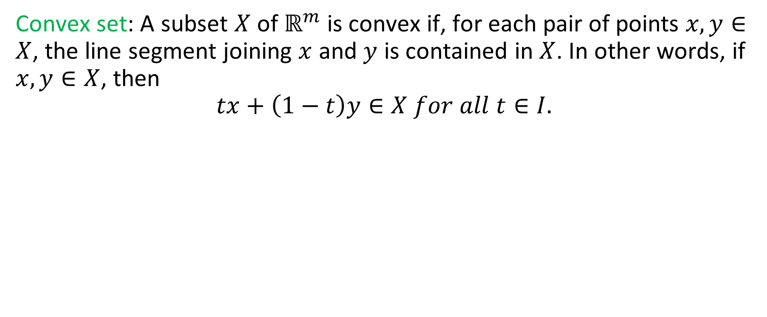
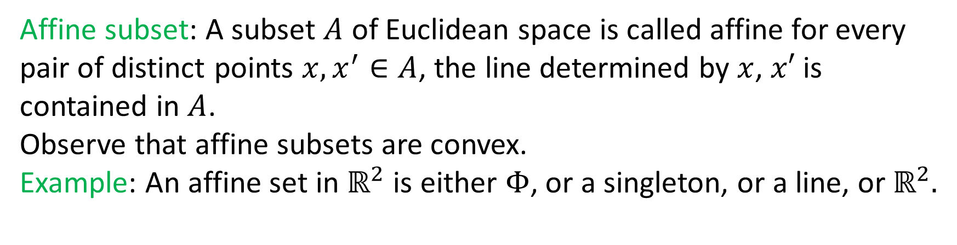
Convex set: A subset $X$ of $ℝ^{m}$ is convex if, for each pair of points $x,y∈X$, the line segment joining $x$ and $y$ is contained in $X$. In other words, if $x,y∈X$, then
$$tx+\left(1−t\right)y∈X for all t∈I.$$
Affine subset: A subset $A$ of Euclidean space is called affine for every pair of distinct points $x,x^{′}∈A$, the line determined by $x$, $x′$ is contained in $A$.
Observe that affine subsets are convex.
Example: An affine set in $ℝ^{2}$ is either $Φ$, or a singleton, or a line, or $ℝ^{2}.$

Slide 7
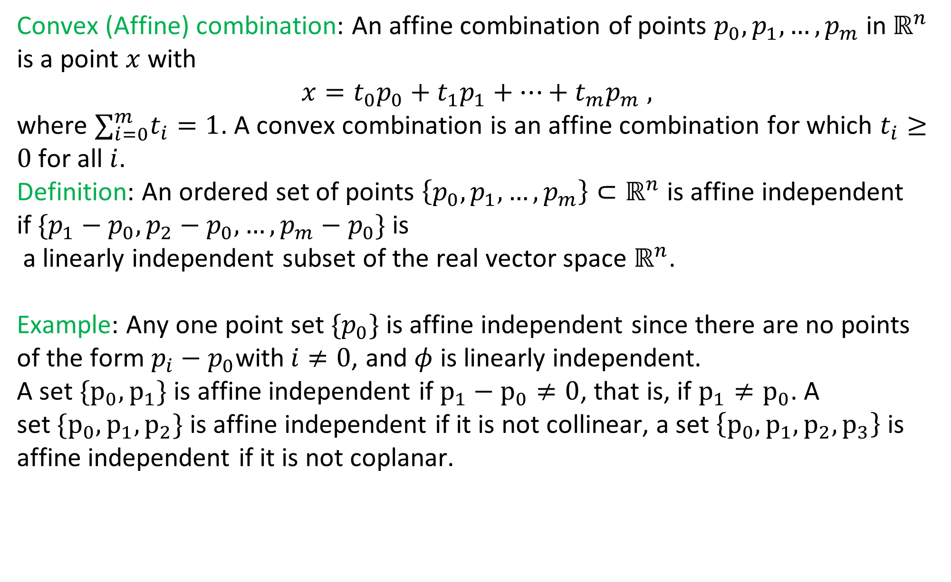
Convex (Affine) combination: An affine combination of points $p_{0},p_{1},…,p_{m}$ in$ℝ^{n}$ is a point $x$ with
$$x=t_{0}p_{0}+t_{1}p_{1}+…+t_{m}p_{m} ,$$
where $∑_{i=0}^{m}t_{i}=1$. A convex combination is an affine combination for which $t_{i}≥0$ for all $i$.
Definition: An ordered set of points $\left\{p_{0},p_{1},…,p_{m}\right\}⊂ℝ^{n}$ is affine independent if$\{p_{1}−p_{0},p_{2}−p_{0}, …,p_{m}−p_{0}\}$ is
a linearly independent subset of the real vector space $ℝ^{n}$.
Example: Any one point set $\{p_{0}\}$ is affine independent since there are no points of the form $p_{i}−p_{0}$with$i≠0$, and $φ$ is linearly independent.
A set $\{p_{0},p_{1}\}$ is affine independent if $p_{1}−p_{0}≠0$, that is, if $p_{1}≠p_{0}$. A set$\{p_{0},p_{1},p_{2}\}$ is affine independent if it is not collinear, a set $\left\{p_{0},p_{1},p_{2},p_{3}\right\}$ is affine independent if it is not coplanar.

Slide 8
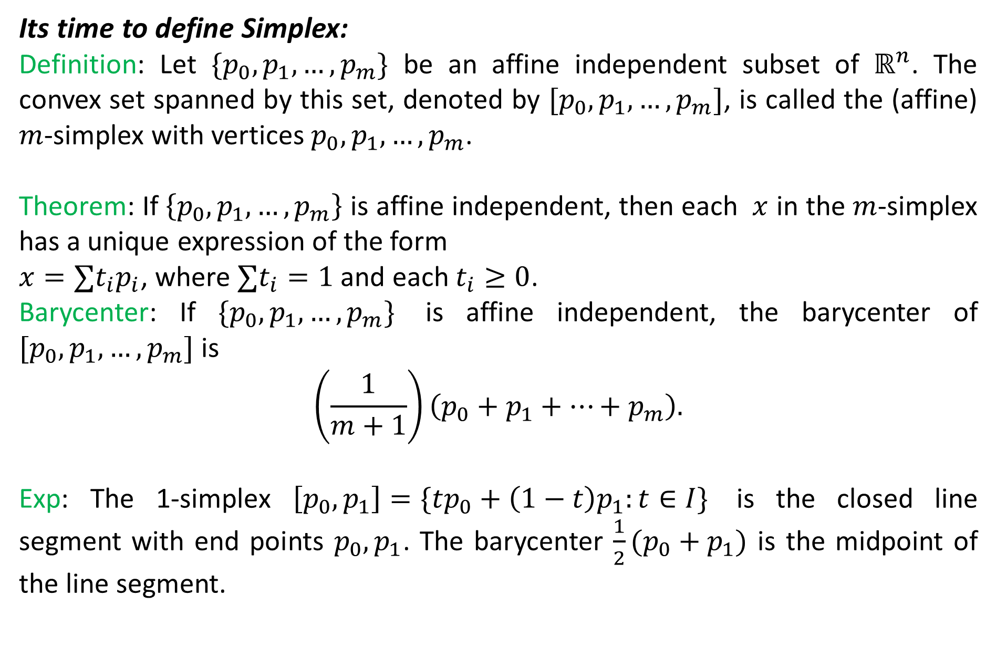
Its time to define Simplex:
Definition: Let $\{p_{0},p_{1},…,p_{m}\}$ be an affine independent subset of $ℝ^{n}$. The convex set spanned by this set, denoted by $[p_{0},p_{1},…,p_{m}]$, is called the (affine) $m$-simplex with vertices $p_{0},p_{1},…,p_{m}$.
Theorem: If $\left\{p_{0},p_{1},…,p_{m}\right\}$ is affine independent, then each $x$ in the $m$-simplex has a unique expression of the form
$x=∑t_{i}p_{i}$, where $∑t_{i}=1$ and each $t_{i}≥0$.
Barycenter: If $\{p_{0},p_{1},…,p_{m}\}$ is affine independent, the barycenter of $[p_{0},p_{1},…,p_{m}]$ is
$$\left(\frac{1}{m+1}\right)\left(p_{0}+p_{1}+…+p_{m}\right).$$
Exp: The 1-simplex $\left[p_{0},p_{1}\right]=\{tp_{0}+\left(1−t\right)p_{1}:t∈I\}$ is the closed line segment with end points $p_{0},p_{1}$. The barycenter $\frac{1}{2}(p_{0}+p_{1})$ is the midpoint of the line segment.

Slide 9
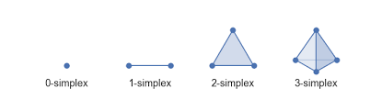
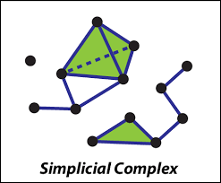

Slide 10
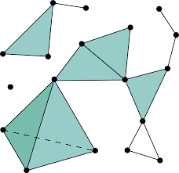
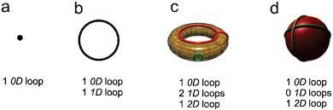
Simplicial Homology

Slide 11
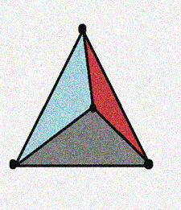
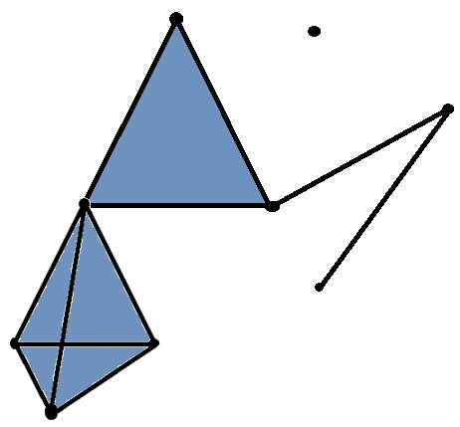
…In simplicial homology we mainly deal with simplicial complex. An n-simplex is the n-dimensional generalization of a triangle in the plane. A simplicial complex is a topological space which can be decomposed as a union of simplices. An example of a simplicial 3- complex can be seen below.

Slide 12
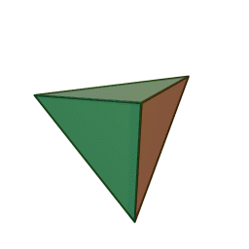
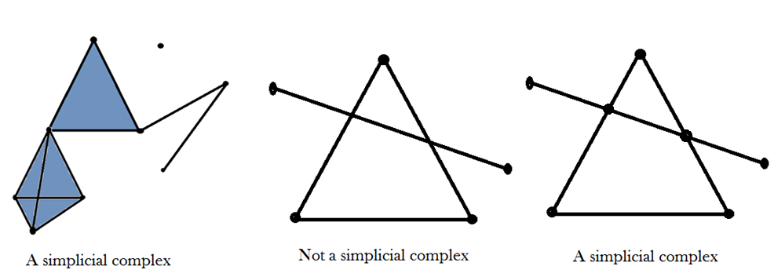
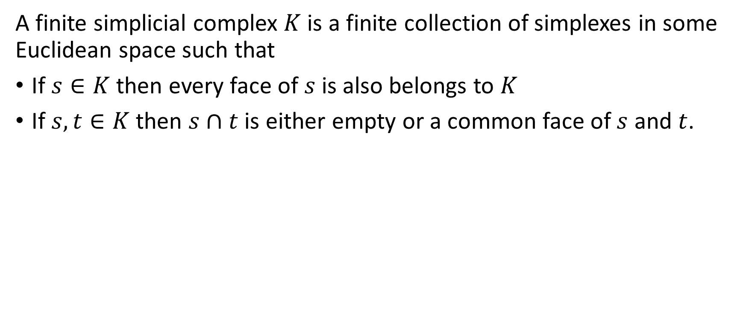
Simplicial Complex
A finite simplicial complex $K$ is a finite collection of simplexes in some Euclidean space such that
If $s∈K$ then every face of $s$ is also belongs to $K$
If $s,t∈K$ then $s∩t$ is either empty or a common face of $s$ and $t$.

Slide 13
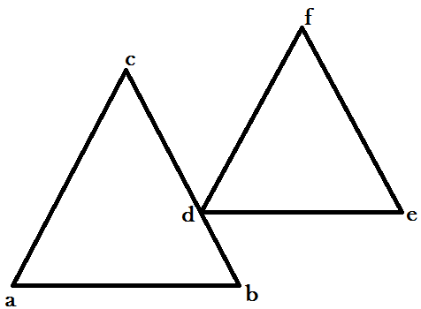
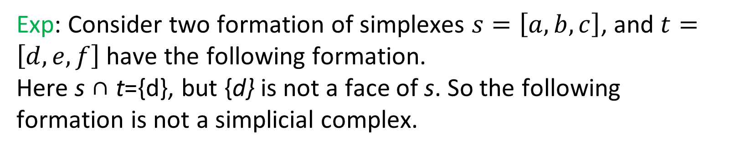
Exp: Consider two formation of simplexes $s=\left[a,b,c\right]$, and $t=\left[d,e,f\right]$ have the following formation.
Here s ∩ t={d}, but {d} is not a face of s. So the following formation is not a simplicial complex.
t
S

Slide 14
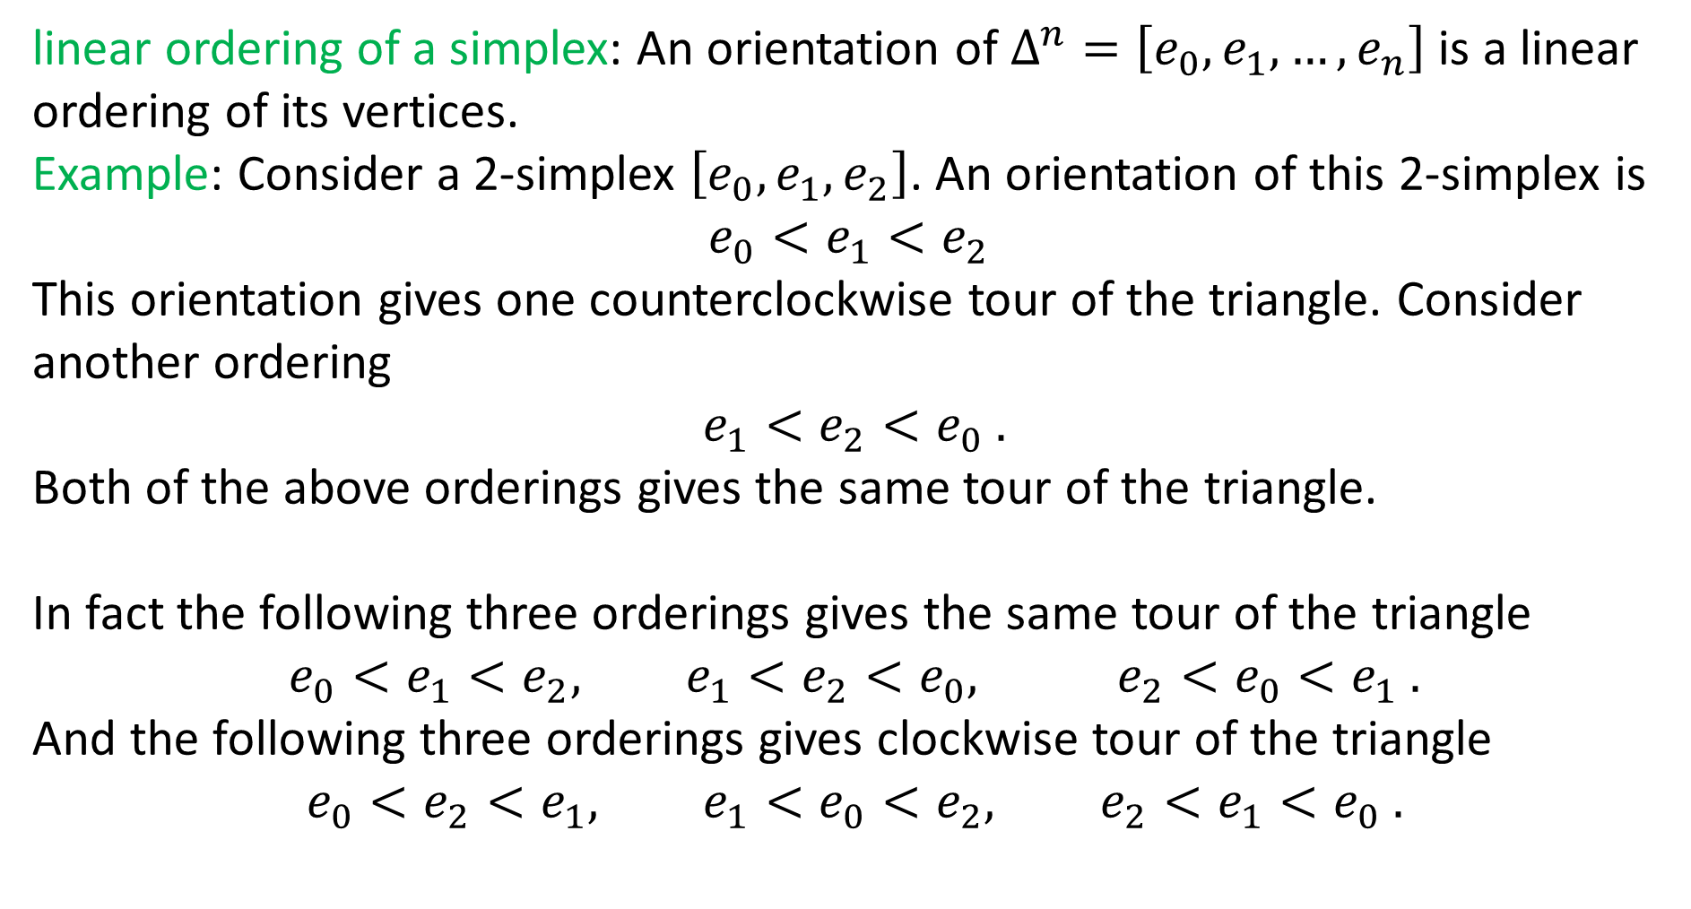
linear ordering of a simplex: An orientation of $Δ^{n}=\left[e_{0},e_{1},…,e_{n}\right]$ is a linear ordering of its vertices.
Example: Consider a 2-simplex $\left[e_{0},e_{1},e_{2}\right]$. An orientation of this 2-simplex is
$$e_{0}<e_{1}<e_{2}$$
This orientation gives one counterclockwise tour of the triangle. Consider another ordering
$$e_{1}<e_{2}<e_{0} .$$
Both of the above orderings gives the same tour of the triangle.
In fact the following three orderings gives the same tour of the triangle
$$e_{0}<e_{1}<e_{2}, e_{1}<e_{2}<e_{0}, e_{2}<e_{0}<e_{1} .$$
And the following three orderings gives clockwise tour of the triangle
$$e_{0}<e_{2}<e_{1}, e_{1}<e_{0}<e_{2}, e_{2}<e_{1}<e_{0} .$$

Slide 15
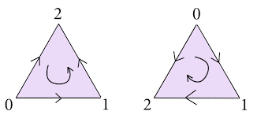
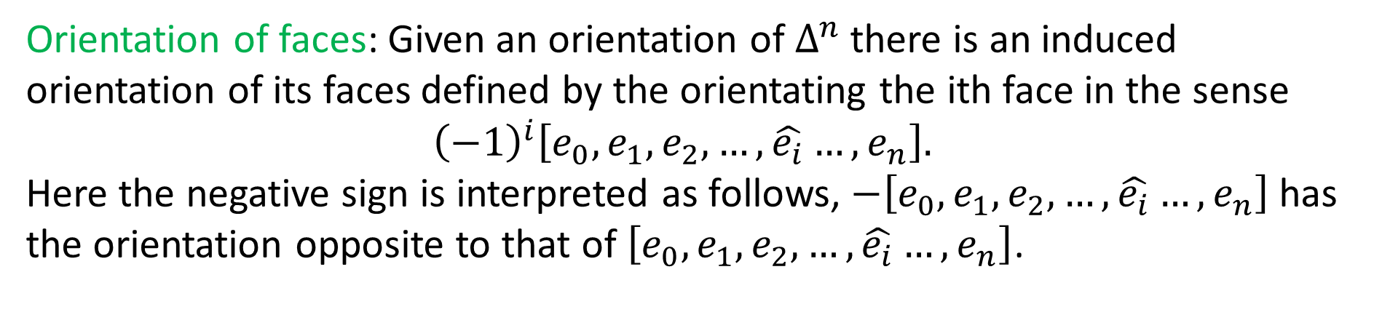
Orientation of faces: Given an orientation of $Δ^{n}$ there is an induced orientation of its faces defined by the orientating the ith face in the sense
$${\left(−1\right)}^{i}\left[e_{0},e_{1},e_{2},…,\hat{e_{i}}…,e_{n}\right].$$
Here the negative sign is interpreted as follows, $−\left[e_{0},e_{1},e_{2},…,\hat{e_{i}}…,e_{n}\right]$ has the orientation opposite to that of $\left[e_{0},e_{1},e_{2},…,\hat{e_{i}}…,e_{n}\right]$.

Slide 16
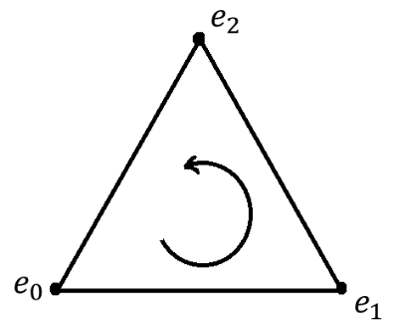
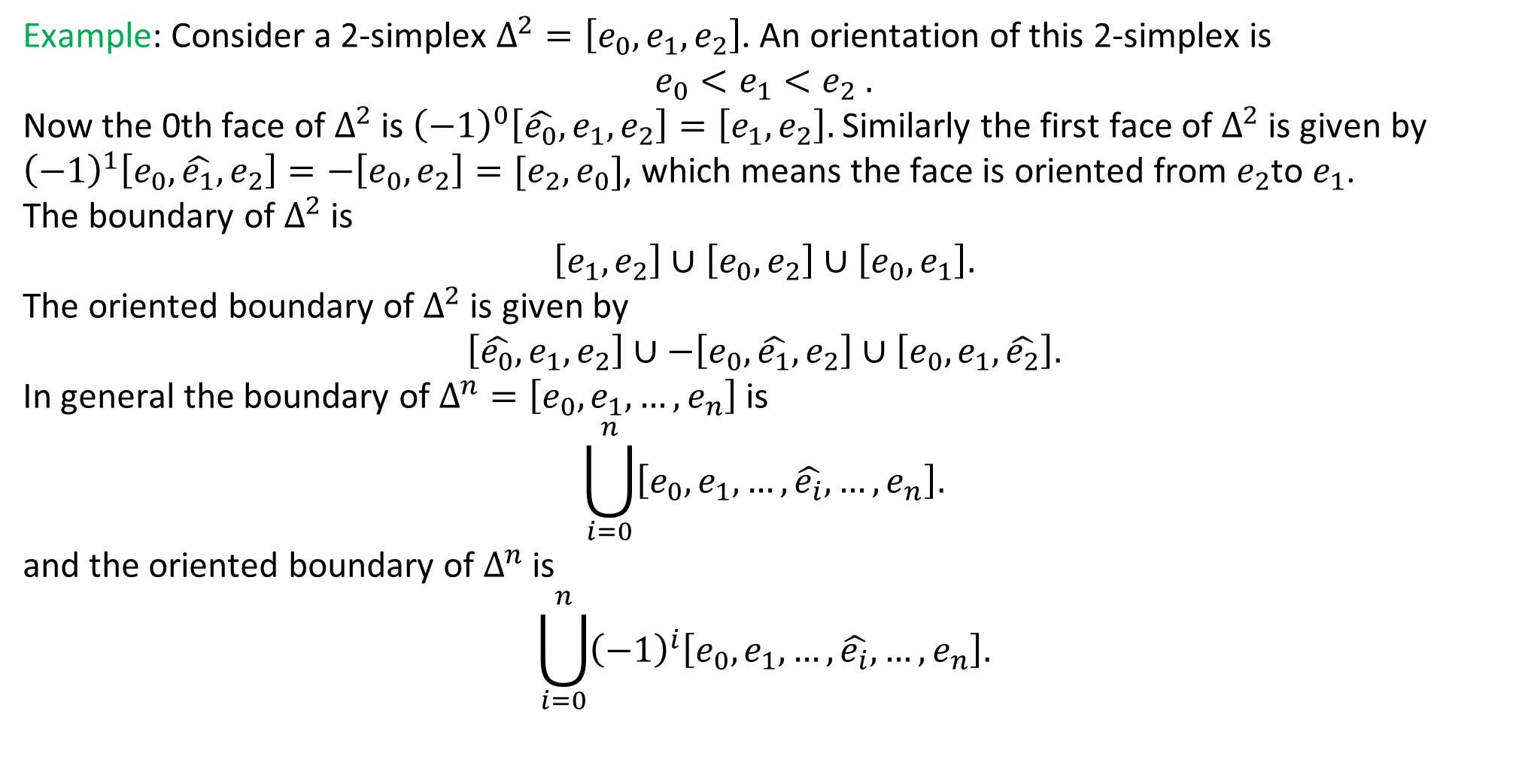
Example: Consider a 2-simplex $Δ^{2}=\left[e_{0},e_{1},e_{2}\right]$. An orientation of this 2-simplex is
$$e_{0}<e_{1}<e_{2} .$$
Now the 0th face of $Δ^{2}$ is ${\left(−1\right)}^{0}\left[\hat{e_{0}},e_{1},e_{2}\right]=\left[e_{1},e_{2}\right].$Similarly the first face of $Δ^{2}$ is given by ${\left(−1\right)}^{1}\left[e_{0},\hat{e_{1}},e_{2}\right]=−\left[e_{0},e_{2}\right]=[e_{2},e_{0}]$, which means the face is oriented from $e_{2}$to $e_{1}$.
The boundary of $Δ^{2}$ is
$$\left[e_{1},e_{2}\right]∪\left[e_{0},e_{2}\right]∪\left[e_{0},e_{1}\right].$$
The oriented boundary of $Δ^{2}$ is given by
$$\left[\hat{e_{0}},e_{1},e_{2}\right]∪−\left[e_{0},\hat{e_{1}},e_{2}\right]∪\left[e_{0},e_{1},\hat{e_{2}}\right].$$
In general the boundary of $Δ^{n}=\left[e_{0},e_{1},…,e_{n}\right]$ is
$$\bigcup_{i=0}^{n}{\left[e_{0},e_{1},…,\hat{e_{i}},…,e_{n}\right].}$$
and the oriented boundary of $Δ^{n}$ is
$$\bigcup_{i=0}^{n}{{\left(−1\right)}^{i}\left[e_{0},e_{1},…,\hat{e_{i}},…,e_{n}\right].}$$

Slide 17
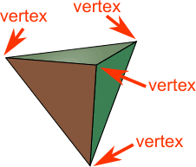
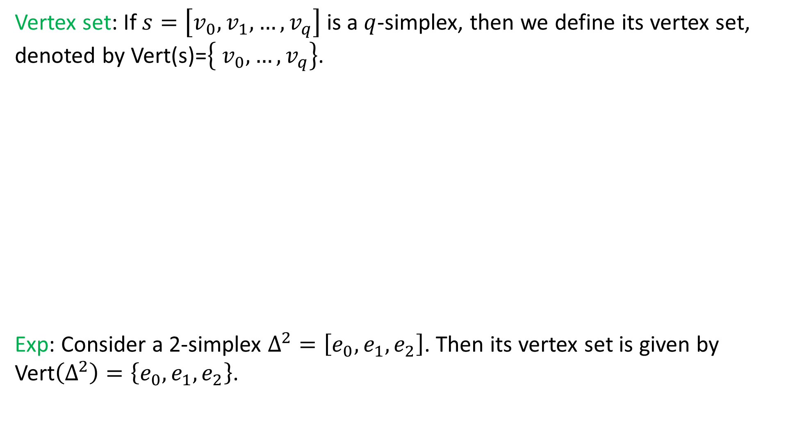
Vertex set: If $s=\left[v_{0},v_{1},…,v_{q}\right]$ is a $q$-simplex, then we define its vertex set, denoted by Vert(s)=$\left\{ v_{0},…,v_{q}\right\}$.
Exp: Consider a 2-simplex $Δ^{2}=\left[e_{0},e_{1},e_{2}\right]$. Then its vertex set is given by
Vert$\left(Δ^{2}\right)=\left\{e_{0},e_{1},e_{2}\right\}$.

Slide 18
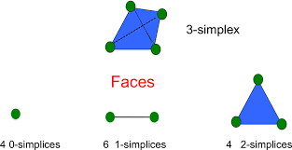
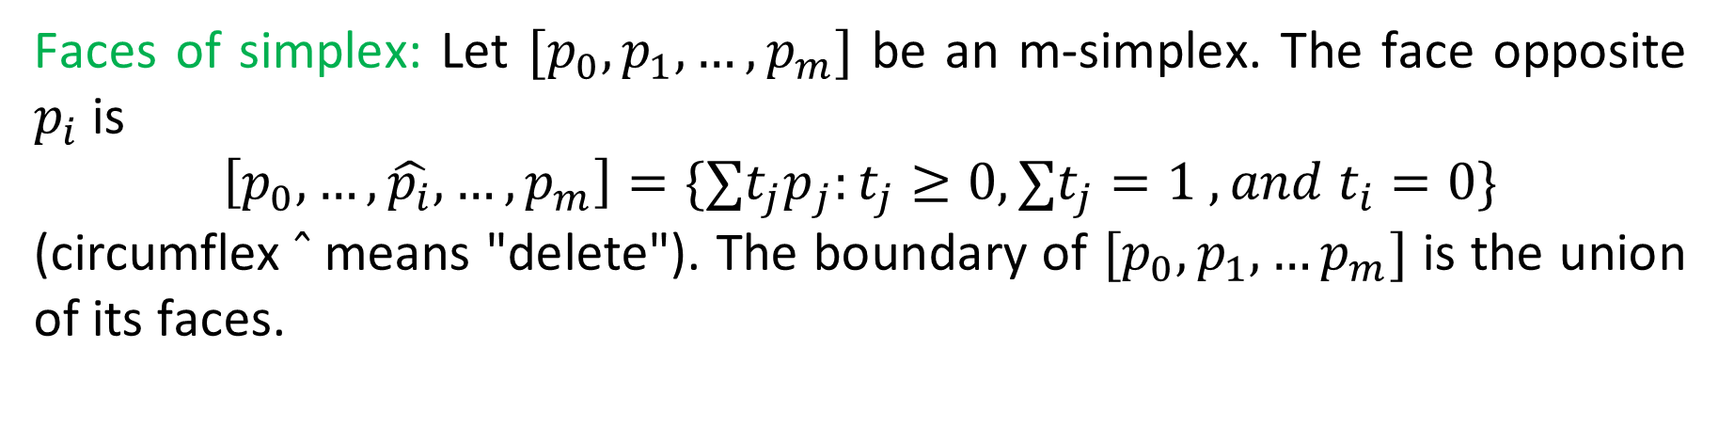
Faces of simplex: Let $[p_{0},p_{1},…,p_{m}]$ be an m-simplex. The face opposite $p_{i}$ is
$$\left[p_{0},…, \hat{p_{i}},…,p_{m}\right]=\{∑t_{j}p_{j}:t_{j}≥0,∑t_{j}=1 , and t_{i}=0\}$$
(circumflex $̂$ means "delete"). The boundary of $[p_{0},p_{1},…p_{m}]$ is the union of its faces.

Slide 19
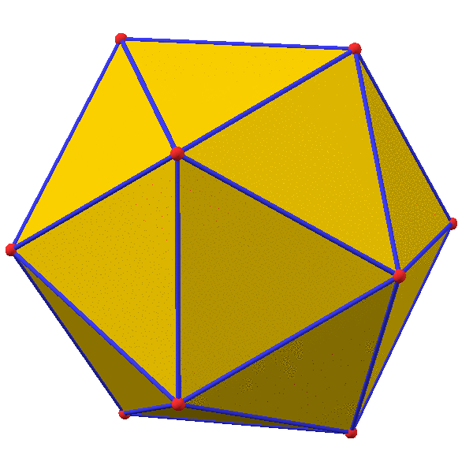
Facet of Simplicial Complex
It’s a geometrical feature of polyhedron, polytope, and simplicial complexes. Facet is a geometric structure, is generally of dimension one less than the structure itself.
In three-dimensional geometry, a facet of a polyhedron is any polygon whose corners are vertices of the polyhedron, and is not a face.
A facet of a simplicial complex is a maximal simplex, that is a simplex that is not a face of another simplex of the complex.

Slide 20
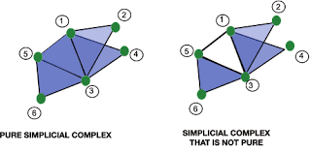
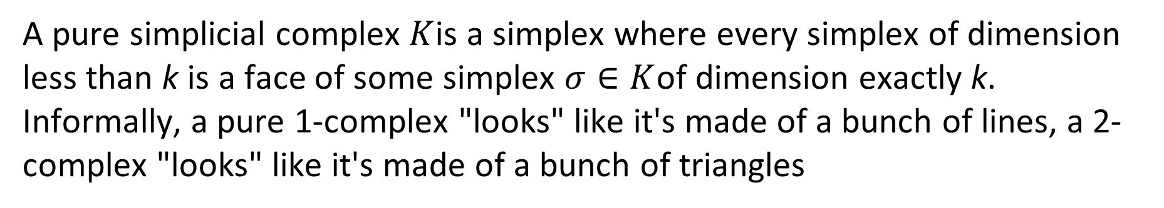
Pure Simplicial Complex
A pure simplicial complex $K$is a simplex where every simplex of dimension less than k is a face of some simplex $σ∈K$of dimension exactly k. Informally, a pure 1-complex "looks" like it's made of a bunch of lines, a 2-complex "looks" like it's made of a bunch of triangles

Slide 21
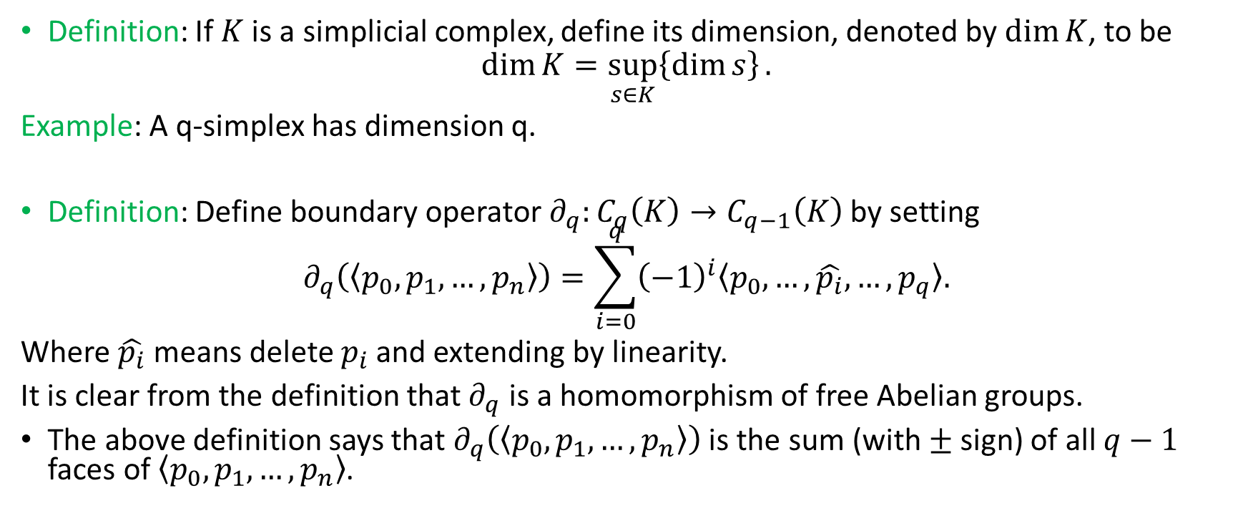
Simplicial Homology
Definition: If $K$ is a simplicial complex, define its dimension, denoted by $\dim{K}$, to be
$$\dim{K=\sup_{s∈K}\left\{\dim{s}\right\}.}$$
Example: A q-simplex has dimension q.
Definition: Define boundary operator $∂_{q}:C_{q}\left(K\right)→C_{q−1}\left(K\right)$ by setting
$$∂_{q}\left(〈p_{0},p_{1},…,p_{n}〉\right)=\sum_{i=0}^{q}{{\left(−1\right)}^{i}〈p_{0},…,\hat{p_{i}},…,p_{q}〉.}$$
Where $\hat{p_{i}}$ means delete $p_{i}$ and extending by linearity.
It is clear from the definition that $∂_{q}$ is a homomorphism of free Abelian groups.
The above definition says that $∂_{q}\left(〈p_{0},p_{1},…,p_{n}〉\right)$ is the sum (with $±$ sign) of all $q−1$ faces of $〈p_{0},p_{1},…,p_{n}〉$.

Slide 22
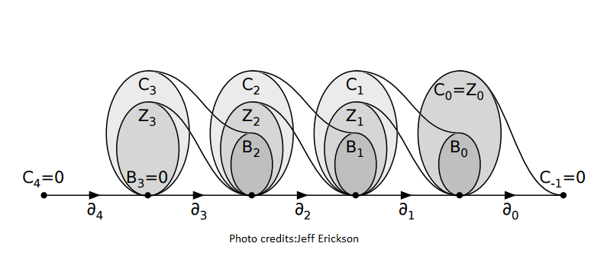
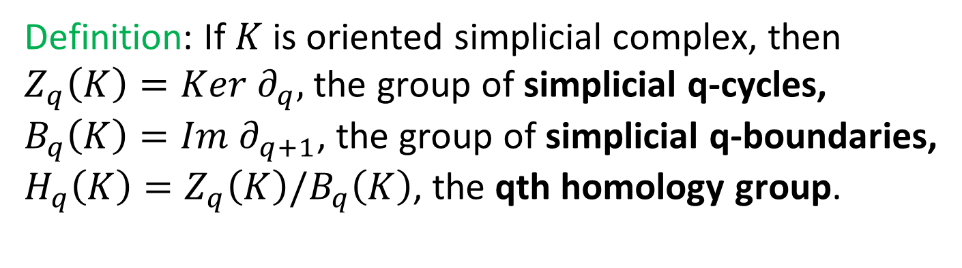
Definition: If $K$ is oriented simplicial complex, then
$Z_{q}\left(K\right)=Ker ∂_{q},$ the group of simplicial q-cycles,
$B_{q}\left(K\right)=Im ∂_{q+1}$, the group of simplicial q-boundaries,
$H_{q}\left(K\right)=Z_{q}\left(K\right)/B_{q}\left(K\right)$, the qth homology group.

Slide 23
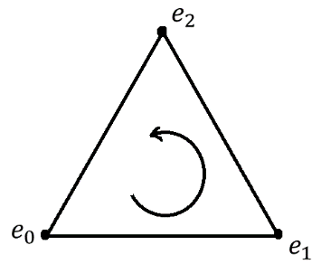
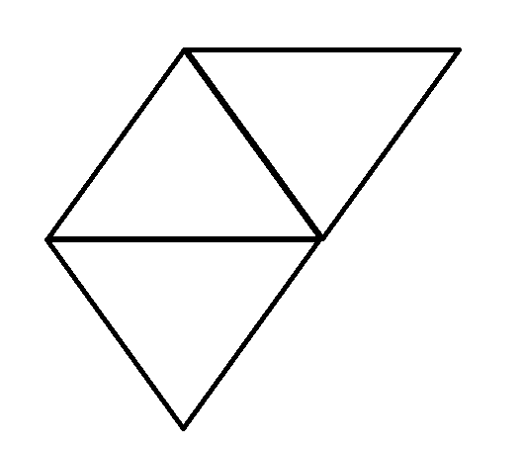
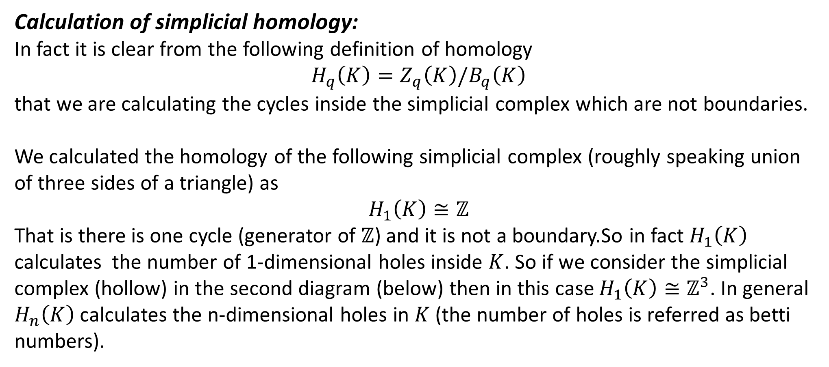
Calculation of simplicial homology:
In fact it is clear from the following definition of homology
$$H_{q}\left(K\right)=Z_{q}\left(K\right)/B_{q}\left(K\right)$$
that we are calculating the cycles inside the simplicial complex which are not boundaries.
We calculated the homology of the following simplicial complex (roughly speaking union of three sides of a triangle) as
$$H_{1}\left(K\right)≅ℤ$$
That is there is one cycle (generator of $ℤ$) and it is not a boundary.So in fact $H_{1}\left(K\right)$ calculates the number of 1-dimensional holes inside $K$. So if we consider the simplicial complex (hollow) in the second diagram (below) then in this case $H_{1}\left(K\right)≅ℤ^{3}$. In general $H_{n}\left(K\right)$ calculates the n-dimensional holes in $K$ (the number of holes is referred as betti numbers).

Slide 24
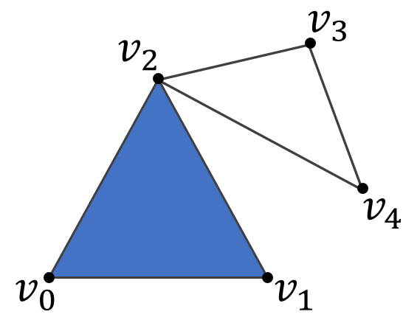
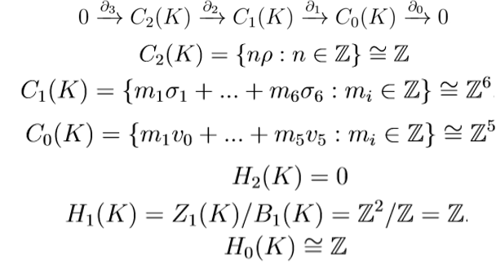
Example:

Slide 25
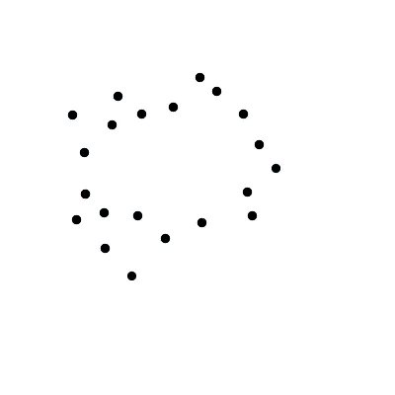
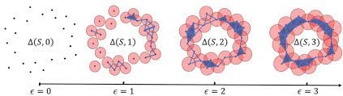
How Simplicial Complex is formed?

Slide 26
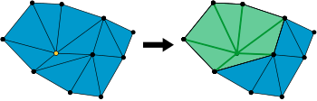
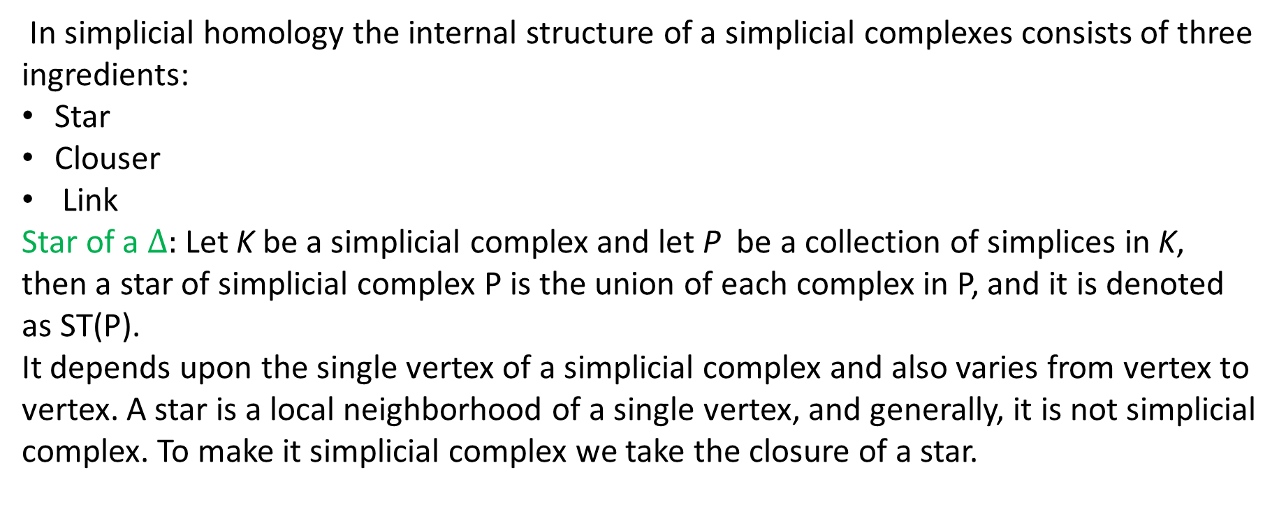
Internal Structure of Simplicial Complex:
In simplicial homology the internal structure of a simplicial complexes consists of three ingredients:
Star
Clouser
Link
Star of a $∆:$ Let K be a simplicial complex and let P be a collection of simplices in K, then a star of simplicial complex P is the union of each complex in P, and it is denoted as ST(P).
It depends upon the single vertex of a simplicial complex and also varies from vertex to vertex. A star is a local neighborhood of a single vertex, and generally, it is not simplicial complex. To make it simplicial complex we take the closure of a star.

Slide 27
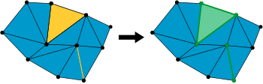
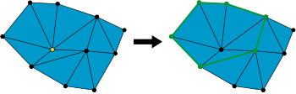
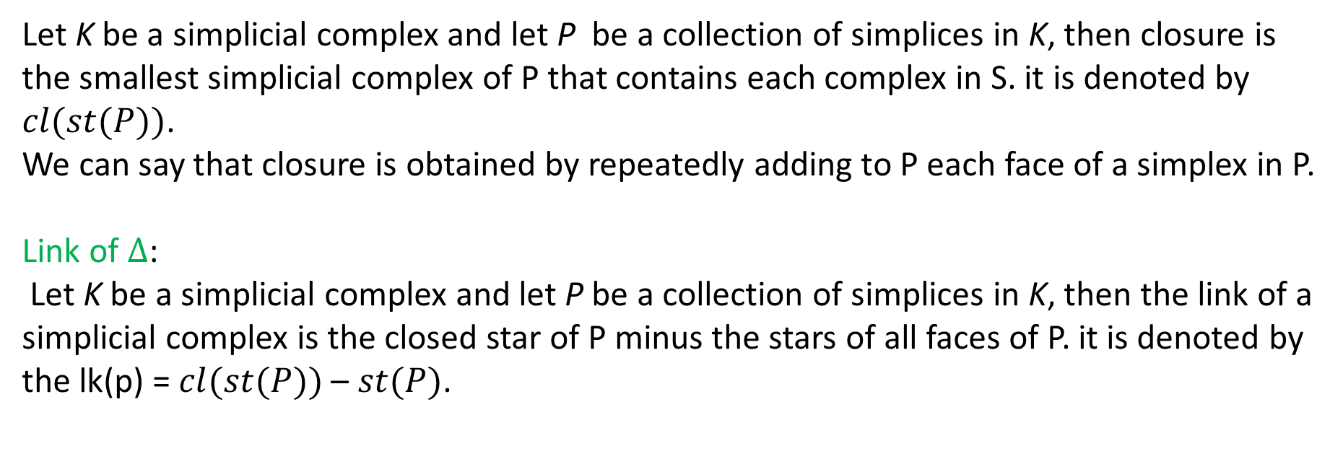

Clouser of $∆$: $cl(st∆)$
Let K be a simplicial complex and let P be a collection of simplices in K, then closure is the smallest simplicial complex of P that contains each complex in S. it is denoted by $cl(st(P))$.
We can say that closure is obtained by repeatedly adding to P each face of a simplex in P.
Link of $∆$:
Let K be a simplicial complex and let P be a collection of simplices in K, then the link of a simplicial complex is the closed star of P minus the stars of all faces of P. it is denoted by the lk(p) = $cl(st(P))$ – $st(P)$.

Slide 28
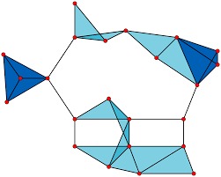


How Simplicial Complex is to be used in high order networks?
Clique Complex:
Let $\left(X,d\right)$be a metric space and consider a graph $G(X,E)$, where X is the vertex set and E is the edge set of graph G. For a parameter $∈$ > 0, we define E = {[x, y]|x, y ∈ X ∧ d(x, y) ≤ $∈$}. Consider a subgraph C ⊆ G, such that for any x $≠$ y we have,
x, y ∈ C $→$ x, y ∈ E known as clique.
A clique C with k + 1 vertices spans a k-simplex, and collection of all the cliques in G are known as clique complex.
NOTE: Every Clique is a simplicial complex
But converse may or may not true???
Counter Example: $X=\{1,2,3\}$

Slide 29


Slide 30

CW Complex
A CW complex is any topological space X built using the following,
Start with a set φ
Add 0-cells
Add 1-cells
Add 2-cells
. . .
Add n-cells
Now collection of at most i-cells is known as i-skeleton, denoted as $X^{i}$ , formed by attaching each i-cell to $X^{i−1}$ skeleton, giving a nested sequence, $X_{0}$ ⊆ $X_{1}$ ⊆ $X_{3}$ ⊆ ... = X

Slide 31


Slide 32


Slide 33

Higher Order Network:

Slide 34


